Slide 1
Prestige Avon
Ğ Dow B
Ğ D own I S
'restige Avon is a Classic, cutting-edge, innovative high-rise residential project in ECC Road, Whitefield, East Bangalore. The Ultra- uxurious apartment project by Prestige Group is spread over 10 Acres. The project allocates 80% of the space to open areas and onIy 0% to construction. It features attractively designed 4 high-rise towers with 230 units of 3, 3.5, 4, and 5 BHK splendid apartments pread across G + 16 floors. The new launch project in Whitefield price starts at 1.8 Cr“. The project will get completed on deadlines
y Dec 2028. This prominent upcoming apartment in Whitefield 2024 Prestige Avon apartments is offered in four topolog ies. Below are ae various floor plan types available with price quotes,
3 BHK
3.5 BHK
4 BHK
5 BHK
1500 sq ft, Starting Price 1800 sq ft, Starting Price
2200 sq ft, Starting Price 3000 sq ft, Starting Price
Rs. 1.8 Crores Onwards Rs. 2.2 Crores Onwards
Rs. 3.8 Crores Onwards Rs. 5.9 Crores Onwards
’vestige Avon project location is at ECC Road, Whitefield, in East Bangalore, Karnataka 560066. It has good access to all areas of the ity through Varthur Road, Hoodi Main Road, and Old Airport Road.
gated community apartment project, Prestige Avon is one of Prestige Group's largest upcoming apartment projects. The project is in lose proximity to Kadugodi Metro Station and Whitefield Railway Station. Also, it is a 15-minute drive from ITPL and has easy access a Sarjapur Road and Hoodi Main Road . This upcoming township project in Bangalore, 2024, a gated community apartment in
\/hitefieId, is near Varthur Lake between Whitefield and Varthur.

Slide 2


Prestige Avon Location
›cation of Prestige Avon is on P attandur Agrahara, ECC Roa d, Whitefield , East Bangalore, Karnataka 560066. It is located in t rn zone of Bangalore near the Varthur Lake.

Slide 3
estige Avon's master plan is spread over 10 acres of land in Whitefield. The layout includes 4 apartment towers, 40+ outdoor enities, and entrance and exit points. The residential project includes 230 units, and the typical floor plan offers 3 BHK 3.5, 4, and 5 lK apartments.
master plan is a deliberate plan that describes how a property will be built. It acts as a guide in developing a project and teIls what ztures will be included.
estige Avon is a single-phased develop ment, and it will be finished by December 2028. The whole project is created by a globally
:ognized architect who will provide residents with an exciting lifestyle.
wer Plan of Prestige Avon

Slide 4
About Floor Plan
ige Avon floor plan consists of 3, 3.5, 4, and SBHK apartments with sizes ranging from 1500 sq. ft to 3,000 sq. ft. It offers a total c nits spread over 4 towers, each having G + 16 floors. The floor plans are designed to meet current market demand s, and it feature inct types.
r plan gives complete information about the built-up area, carpet area, and the super built-up area. It gives complete information the rooms of a house when it is viewed from above.
partments in various sizes are mentioned below,
Type Size
BHK 1500 sq. ft.
BH K 1800 sq. ft.
BHK
2200 sq. ft.
BHK
3000 sq. ft.

Slide 5










Prestige Avon Amenities
Lynnnasium
Swimming Pool
Yoga Pavilion
Video Door Phone
Kids Activity Zone
Mini TI
ennis C ourt
Indoor Games Room
Club House
Dance/M usic
24/7 CCTV
Monitor ing
Joggin g

Slide 6
Prestige AYon
Home
Location
Master Plan
Floor Plan Price Amenities Gallery Specifications
Contact
Brochure
Prestige Avon
Ğ Dow BLoch re
Ğ D own osI S eet
Prestige Avon is a Classic, cutting-edge, innovative high-rise residential project in ECC Road, Whitefield, East Bangal ore. The Ultra- Luxurious apartment project by Prestige Group is spread over 10 Acres. The project allocates 80% of the space to open areas and onIy 20% to construction. It features attractively designed 4 high-rise towers with 230 units of 3, 3.5, 4, and 5 BHK splendid apartments spread across G + 16 floors. The new launch project in Whitefield price starts at 1.8 Cr“. The project will get completed on deadlines by Dec 2028. This prominent upcoming apartment in Whitefield 2024 Prestige Avon apartments is offered in four topologies. Below are the various floor plan types available with price quotes,
3 BHK - 1500 sq ft, Starting Price - Rs. 1.8 Crores Onwards
3.5 BHK - 1800 sq ft, Starting Price - Rs. 2.2 Crores Onwards
4 BHK - 2200 sq ft, Starting Price - Rs. 3.8 Crores Onwards
5 BHK - 3000 sq ft, Starting Price - Rs. 5.9 Crores Onwards
Prestige Avon project location is at ECC Road, Whitefield, in East Bangalore, Karnataka 560066. It has good access to all areas of the city through Varthur Road, Hoodi Main Road, and Old Airport Road.
A gated community apartment project, Prestige Avon is one of Prestige Group's largest upcoming apartment projects. The project is in
clo R
K ad odi Met : a oTand Wh' eld R: on ARso 15n nute dt ve rom I: a: eta y access n n n n /n n Shri itL drh * n
eri

Slide 7
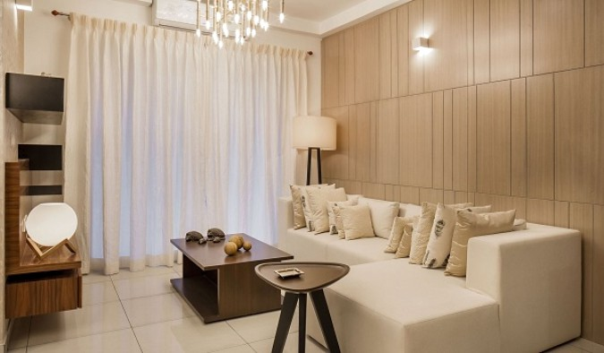
Prestige Avon Specifications
,tige Avon specifications include PVC-insulated copper wires, vitrified tiles, an RCC framed structure, chrome-plated fittings, nated flush shutters, wood doors, and sliding shutters.
.tige Avon Specifications boasts world-class standards. The project features 230 opulent homes dispersed over a massive 10 acres ‹
. Apartments are developed over 4 towers with a ground floor and 16 floors. The whole enclave is constructed using the best
*rials of top qua lity.

