Slide 1
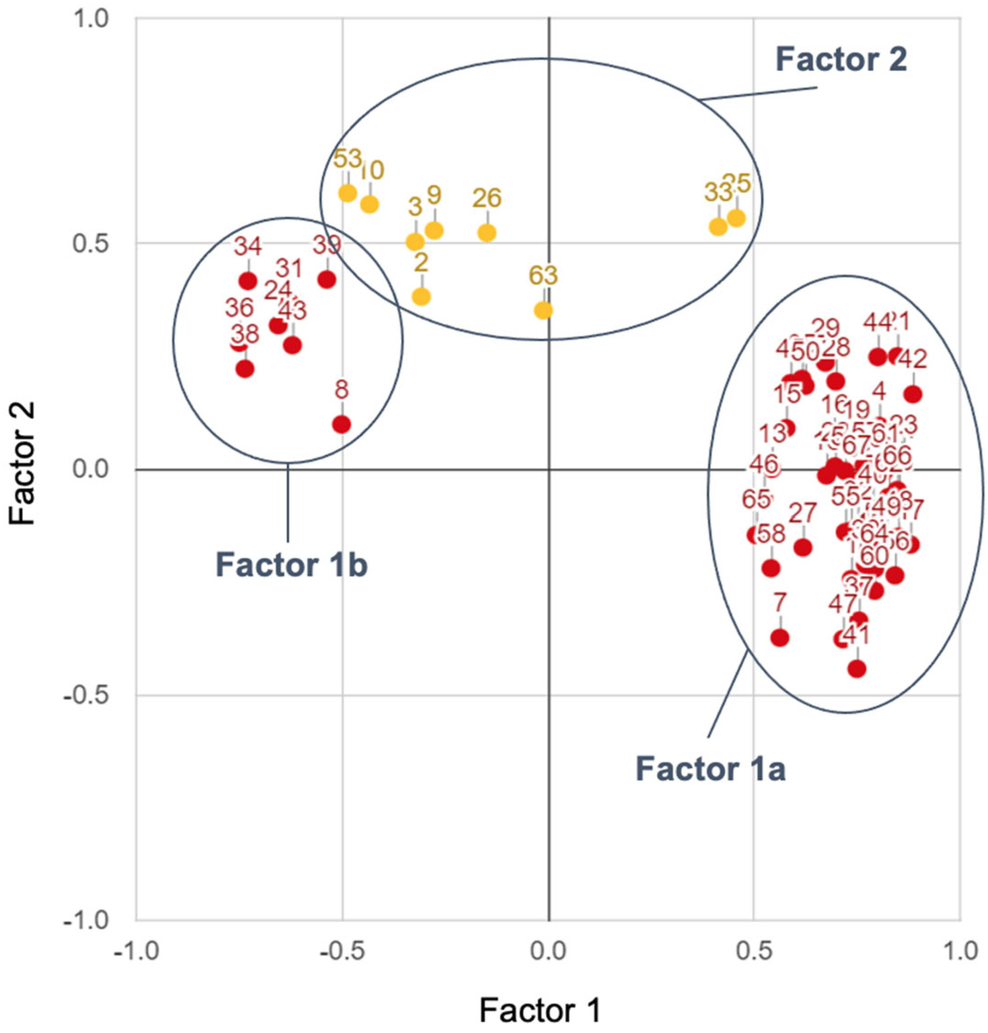
Divergent values and perspectives drive three distinct viewpoints on grizzly bear reintroduction in Washington, the United States
People and Nature, Volume: 7, Issue: 1, Pages: 127-145, First published: 17 November 2024, DOI: (10.1002/pan3.10748)
Notes:
Q sort positions relative to two extracted factors following judgmental rotation (−10°). Red dots and numbers show individual Q sorts that significantly load onto Factor 1. The two clusters of red dots represent Q sorts that loaded positively and negatively onto Factor 1, representing essentially opposing viewpoints. Yellow dots and numbers show individual Q sorts that significantly load onto Factor 2. Loadings were considered significant at p < 0.05. See Table S1 for exact factor loadings of each participant.
IF THIS IMAGE HAS BEEN PROVIDED BY OR IS OWNED BY A THIRD PARTY, AS INDICATED IN THE CAPTION LINE, THEN FURTHER PERMISSION MAY BE NEEDED BEFORE ANY FURTHER USE. PLEASE CONTACT WILEY'S PERMISSIONS DEPARTMENT ON PERMISSIONS@WILEY.COM OR USE THE RIGHTSLINK SERVICE BY CLICKING ON THE 'REQUEST PERMISSIONS' LINK ACCOMPANYING THIS ARTICLE. WILEY OR AUTHOR OWNED IMAGES MAY BE USED FOR NON-COMMERCIAL PURPOSES, SUBJECT TO PROPER CITATION OF THE ARTICLE, AUTHOR, AND PUBLISHER.

