Slide 1
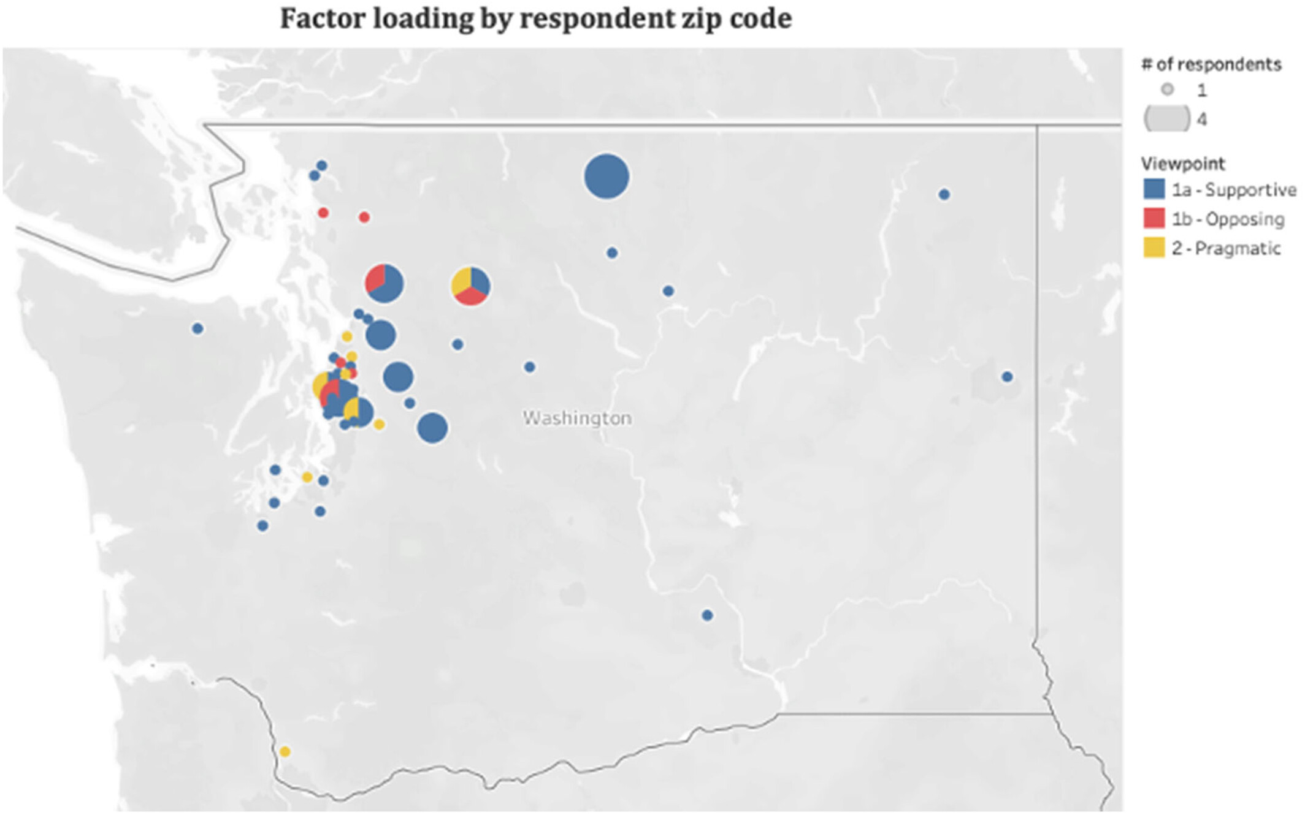
Divergent values and perspectives drive three distinct viewpoints on grizzly bear reintroduction in Washington, the United States
People and Nature, Volume: 7, Issue: 1, Pages: 127-145, First published: 17 November 2024, DOI: (10.1002/pan3.10748)
Notes:
Map of factor loadings by each respondents' zip code. Dots are placed in the centre of each zip code area. Five respondents listed zip codes outside of Washington: One in Alaska, two in Oregon, one in California and one in Montana. The California respondent loaded onto Factor 1b, all the others loaded onto Factor 1a. Factor loadings should not be generalized to wider spatial extents; this is only meant to show our individual respondents' distribution in comparison to each other.
IF THIS IMAGE HAS BEEN PROVIDED BY OR IS OWNED BY A THIRD PARTY, AS INDICATED IN THE CAPTION LINE, THEN FURTHER PERMISSION MAY BE NEEDED BEFORE ANY FURTHER USE. PLEASE CONTACT WILEY'S PERMISSIONS DEPARTMENT ON PERMISSIONS@WILEY.COM OR USE THE RIGHTSLINK SERVICE BY CLICKING ON THE 'REQUEST PERMISSIONS' LINK ACCOMPANYING THIS ARTICLE. WILEY OR AUTHOR OWNED IMAGES MAY BE USED FOR NON-COMMERCIAL PURPOSES, SUBJECT TO PROPER CITATION OF THE ARTICLE, AUTHOR, AND PUBLISHER.

