Slide 1
Prestige Oakville

Slide 2
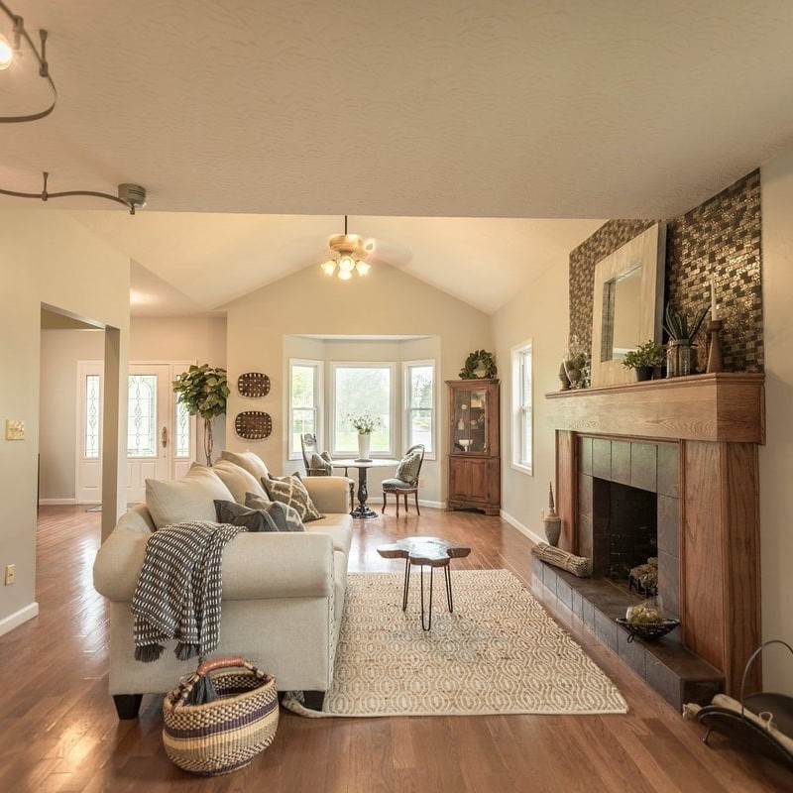
Welcome to Prestige Oakville
Prestige Group, a renowned builder, created Prestige Oakville, a cutting-edge residential township strategically situated near Whiteﬁeld, Bangalore. Scattered over a large area, it provides roomy apartments with 1, 2, 3, and 4 bedrooms. This new housing project, Prestige Oakville, is one of the best upcoming projects in Whiteﬁeld.

Slide 3
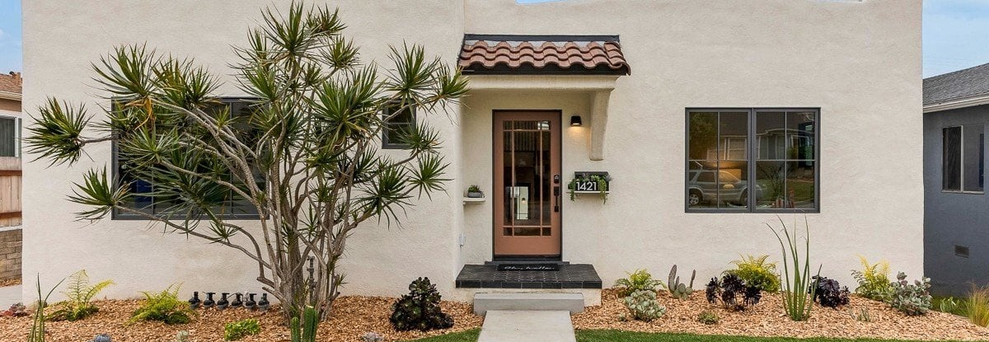
Perfectly situated in Whiteﬁeld, on Bangalore's eastern outskirts, is Prestige Oakville Location. There are several work opportunities close to the city's main IT hubs. Buyers love to invest in Prestige Oakville because it provides the ﬁnest access to all of the city's top districts.

Slide 4
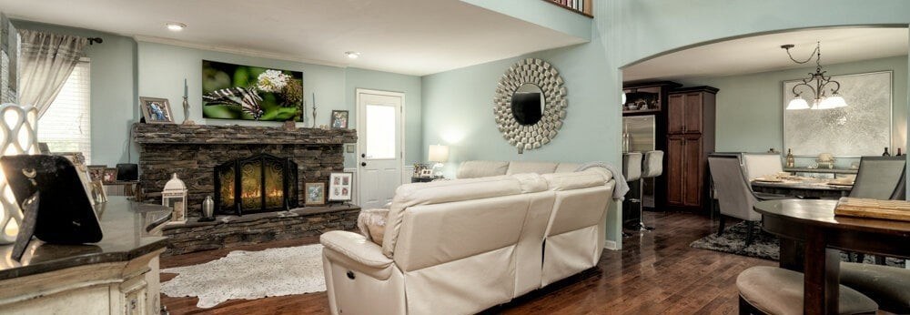
The carefully planned high-rise residential buildings in Prestige Oakville Master Plan are encircled by beautiful green spaces and contemporary facilities. There are 20% of the township's areas under construction and 80% of it is open land. It offers various-sized apartments with 1, 2, 3, and 4 bedrooms. The project launch will shortly precede the availability of the master plan.

Slide 5

Culinary Delights
Pristine Oakville price is Rs. 60 lakhs and above. Prestige Oakville has a wide selection of apartments to suit the various budgets of potential tenants. The size, layout, and tower placement of the ﬂats all affect how much each unit costs. There is an extra cost associated with ﬂoor rising.

Slide 6
Thanks!

